Slide 1
Module 2: Body Fat
Group 5: Yukun Fang, Mengkun Chen, Jiayi Shen

Slide 2

Goal
Want to find a simple, accurate and robust method to predict body fat percentage using available circumference measurements.

Slide 3
Data Cleaning
We deleted two observations due to small body fat %.
IDNO | BODYFAT | DENSITY | AGE | WEIGHT | HEIGHT | … | FOREARM | WRIST
182 | 0 | 1.1089 | 40 | 118.5 | 68 | … | 24.6 | 16.5
172 | 1.9 | 1.0983 | 35 | 125.75 | 65.5 | … | 25.9 | 16.9

Slide 4

Data Cleaning
We fixed one record because of incorrect height.
$$ADIPOSITY=\frac{WEIGHT(lbs)}{{HEIGHT(inch)}^{2}}∙703$$
IDNO | BODYFAT | DENSITY | AGE | WEIGHT | HEIGHT | ADIPOSITY | …
42 | 31.7 | 1.025 | 44 | 205 | 29.5 | 29.9 | …

Slide 5
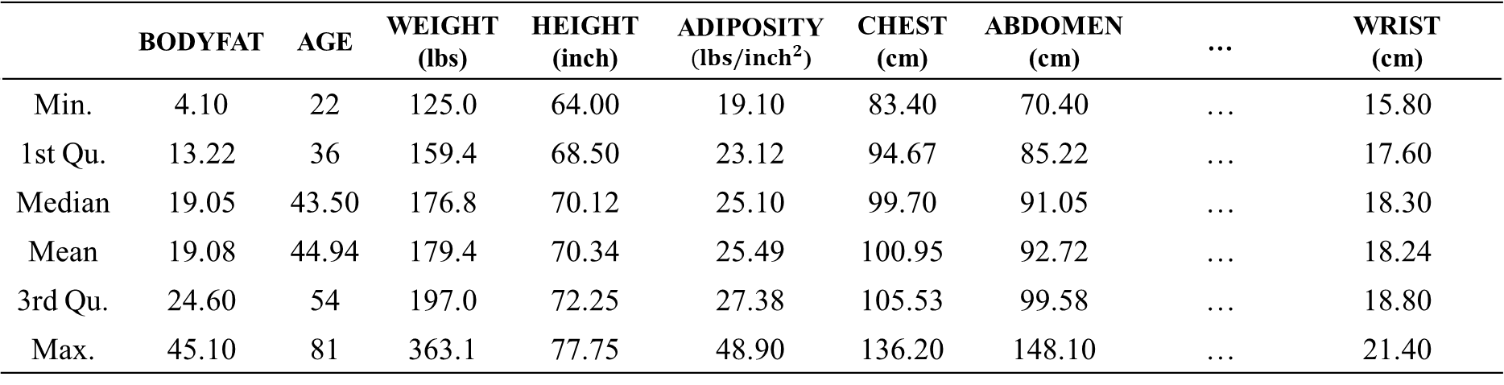
Data Cleaning
250 observations and 14 predictors
Table Summary Statistics
 | BODYFAT | AGE | WEIGHT (lbs) | HEIGHT (inch) |  | CHEST (cm) | ABDOMEN (cm) | … | WRIST (cm)
Min. | 4.10 | 22 | 125.0 | 64.00 | 19.10 | 83.40 | 70.40 | … | 15.80
1st Qu. | 13.22 | 36 | 159.4 | 68.50 | 23.12 | 94.67 | 85.22 | … | 17.60
Median | 19.05 | 43.50 | 176.8 | 70.12 | 25.10 | 99.70 | 91.05 | … | 18.30
Mean | 19.08 | 44.94 | 179.4 | 70.34 | 25.49 | 100.95 | 92.72 | … | 18.24
3rd Qu. | 24.60 | 54 | 197.0 | 72.25 | 27.38 | 105.53 | 99.58 | … | 18.80
Max. | 45.10 | 81 | 363.1 | 77.75 | 48.90 | 136.20 | 148.10 | … | 21.40

Slide 6

Finding Best Model
Candidate models:
Model 1: BODYFAT ~ AGE + ADIPOSITY
(formula from Wikipedia: https://en.wikipedia.org/wiki/Body_fat_percentage#From_BMI)
Model 2: BODYFAT ~ WEIGHT + ABDOMEN + FOREARM + WRIST
(selected by both direction selection using BIC criterion)
Model 3: Principal component regression
(linear regression using first three principal components determined by eight main predictors)

Slide 7
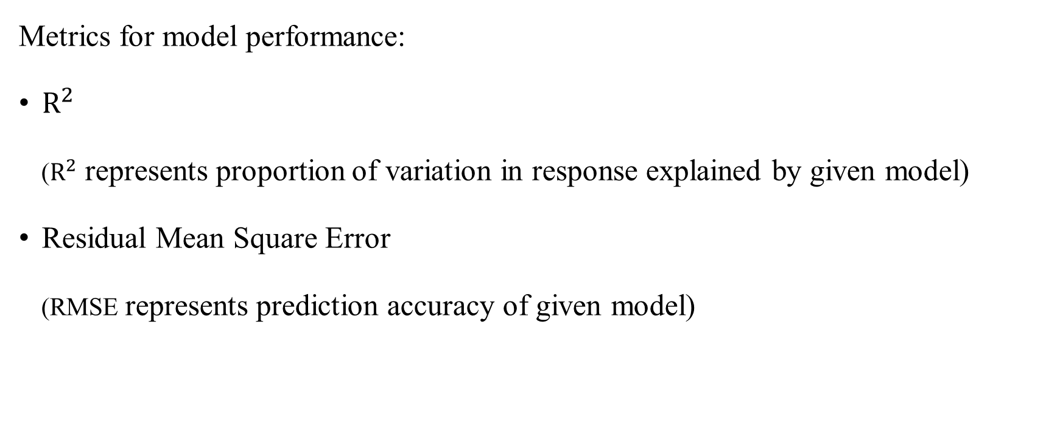
Finding Best Model
Metrics for model performance:
$R^{2}$
($R^{2}$ represents proportion of variation in response explained by given model)
Residual Mean Square Error
(RMSE represents prediction accuracy of given model)

Slide 8
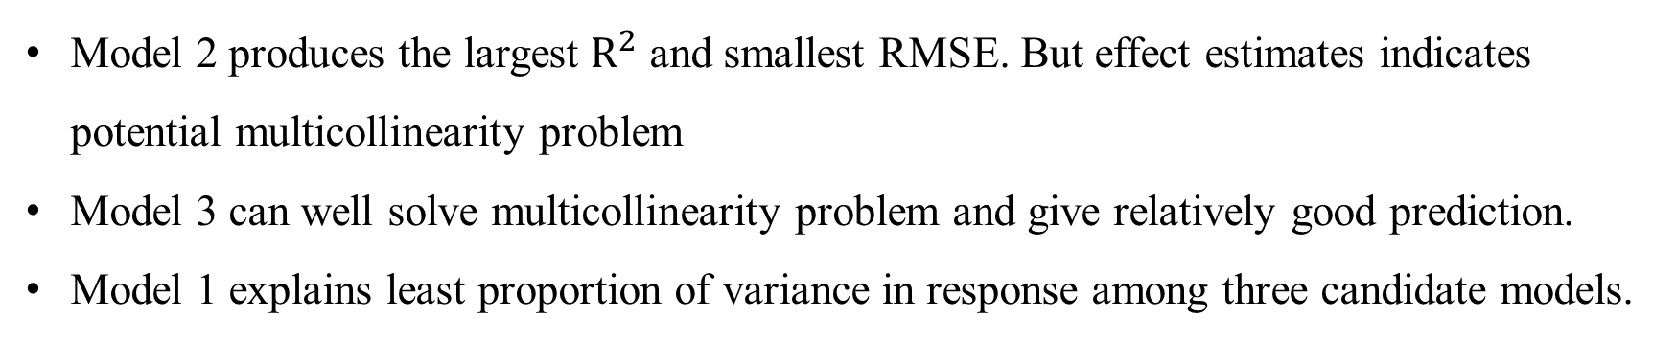
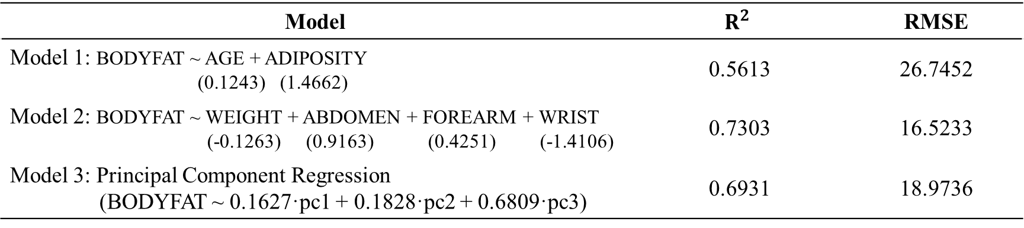
Comparison
Model |  | RMSE
Model 1: BODYFAT ~ AGE + ADIPOSITY (0.1243) (1.4662) | 0.5613 | 26.7452
Model 2: BODYFAT ~ WEIGHT + ABDOMEN + FOREARM + WRIST (-0.1263) (0.9163) (0.4251) (-1.4106) | 0.7303 | 16.5233
Model 3: Principal Component Regression (BODYFAT ~ 0.1627·pc1 + 0.1828·pc2 + 0.6809·pc3) | 0.6931 | 18.9736
Model 2 produces the largest $R^{2}$ and smallest RMSE. But effect estimates indicates potential multicollinearity problem
Model 3 can well solve multicollinearity problem and give relatively good prediction.
Model 1 explains least proportion of variance in response among three candidate models.

Slide 9

Final Model
Principal components regression
Calculate covariance matrix of predictors. Find eigen values (λ’s) and eigen vectors (e’s) of the covariance matrix.
Keep those principal components whose cumulated variance reaches 95% of total variance.
Do multiple linear regression on these selected principal components.

Slide 10
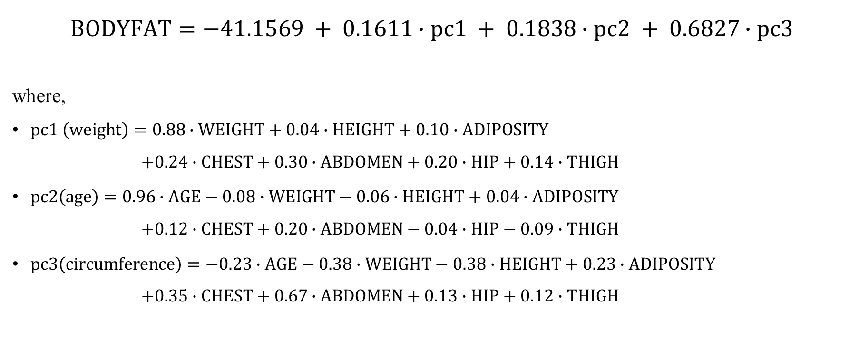
Final Model
$$BODYFAT=−41.1569 + 0.1611∙pc1 + 0.1838∙pc2 + 0.6827∙pc3$$
where,
$pc1 \left(weight\right)=0.88∙WEIGHT+0.04∙HEIGHT+0.10∙ADIPOSITY$ $+0.24∙CHEST+0.30∙ABDOMEN+0.20∙HIP+0.14∙THIGH$
$pc2\left(age\right)=0.96∙AGE−0.08∙WEIGHT−0.06∙HEIGHT+0.04∙ADIPOSITY$ $+0.12∙CHEST+0.20∙ABDOMEN−0.04∙HIP−0.09∙THIGH$
$pc3\left(circumference\right)=−0.23∙AGE−0.38∙WEIGHT−0.38∙HEIGHT+0.23∙ADIPOSITY$ $+0.35∙CHEST+0.67∙ABDOMEN+0.13∙HIP+0.12∙THIGH$

Slide 11

Final Model
Re-express final model in original predictors:
$$BODYFAT=−41.16+0.02∙AGE−0.13∙WEIGHT−0.26∙HEIGHT+0.18∙ADIPOSITY$$ $+0.30∙CHEST+0.54∙ABDOMEN+0.11∙HIP+0.09∙THIGH$

Slide 12
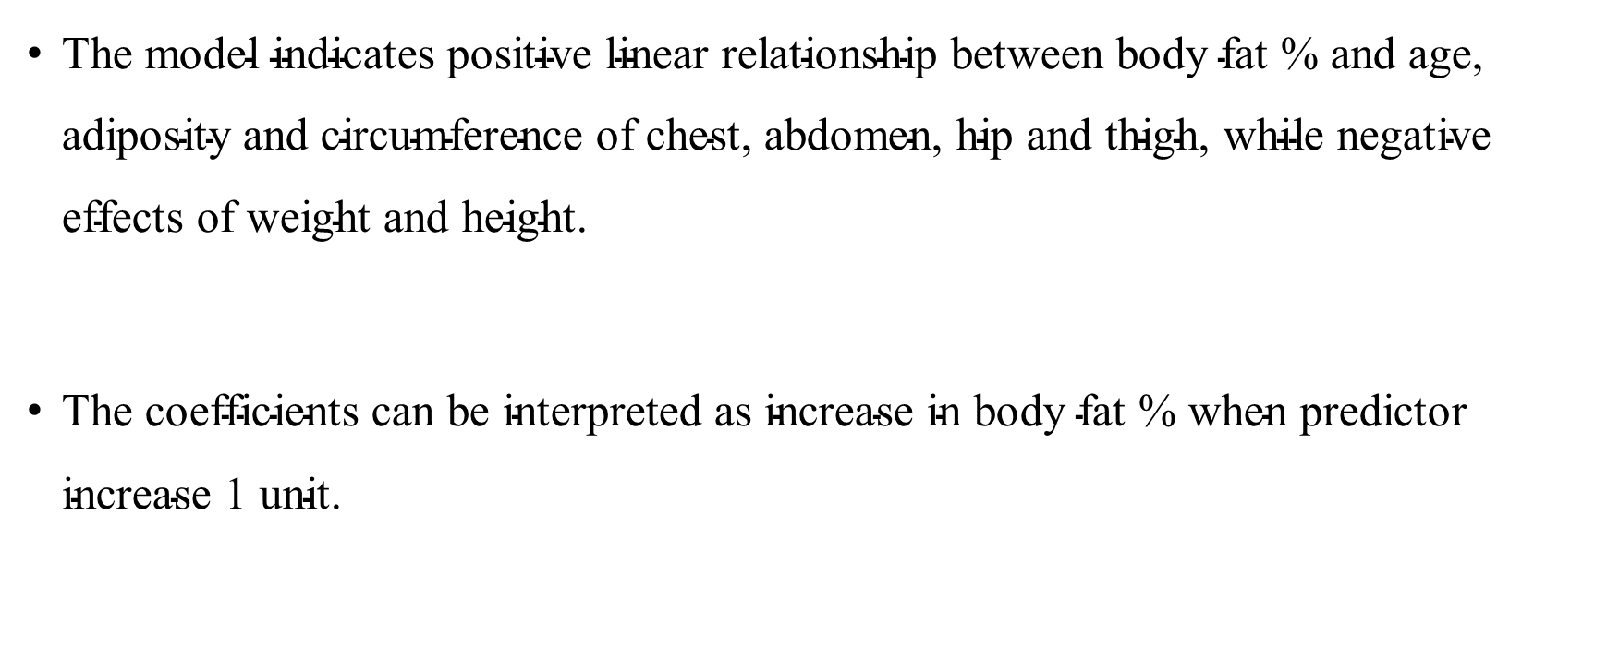
Final Model
$\text{The} \text{model} \text{indicates} \text{positive} \text{linear} \text{relationship} \text{between} \text{body} \text{fat}\text{ \% }\text{and} \text{age}\text{, }\text{adiposity} \text{and} \text{circumference} \text{of} \text{chest}\text{, }\text{abdomen}\text{, }\text{hip} \text{and} \text{thigh}\text{, }\text{while} \text{negative} \text{effects} \text{of} \text{weight} \text{and} \text{height}\text{. }$
$\text{The} \text{coefficients} \text{can} \text{be} \text{interpreted} \text{as} \text{increase} \text{in} \text{body} \text{fat}\text{ \% }\text{when} \text{predictor} \text{increase}\text{ 1 }\text{unit}\text{.}$

Slide 13
Statistical Properties of Final Model
Coefficients of all principal components are all significant under 0.05 confidence level.
Standard errors of all estimated effects are quite small
 | Estimate | Std. Error | t value | Pr(>|t|)
(Intercept) | -41.16 | 2.588 | -15.901 | <2e-16
pc1 | 0.16 | 0.009 | 18.058 | <2e-16
pc2 | 0.18 | 0.020 | 8.984 | <2e-16
pc3 | 0.68 | 0.058 | 11.800 | <2e-16

Slide 14
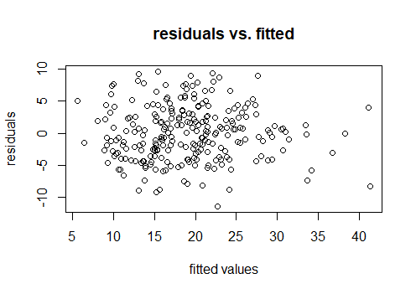
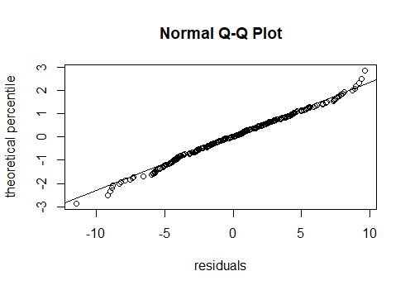
Final Model
The two figures show model assumptions are satisfied.

Slide 15

Model Strengths/Weaknesses
$$\text{Strengths}\text{: }$$
$\text{A}\text{void} \text{multicollinearity} \text{between} \text{predictors}$
$\text{A}\text{ccurate} \text{estimates}$
Pre-abandon several insignificant predictors, producing more concise model

Slide 16

Model Strengths/Weaknesses
$$\text{Weaknesses}\text{:}$$
$\text{E}\text{stimated} \text{variance} \text{is} \text{quite} \text{large} \text{and} \text{R}\text{2} \text{is} \text{not} \text{close} \text{to}\text{ 1}$
$\text{U}\text{se} \text{empirical}\text{ 95\% }\text{of} \text{cumulative} \text{total} \text{variance}\text{, }\text{rather} \text{than} \text{using} \text{variable} \text{selection} \text{method} \text{in} \text{linear} \text{regression}$

Slide 17

Further Improvments
$\text{use} \text{variable} \text{selection} \text{methods}$
$\text{include} \text{nonlinear} \text{terms} \text{in} \text{the} \text{model}$
$\text{use} \text{other} \text{techniques} \text{to} \text{better} \text{deal} \text{with} \text{multicollinearity}$

Slide 18
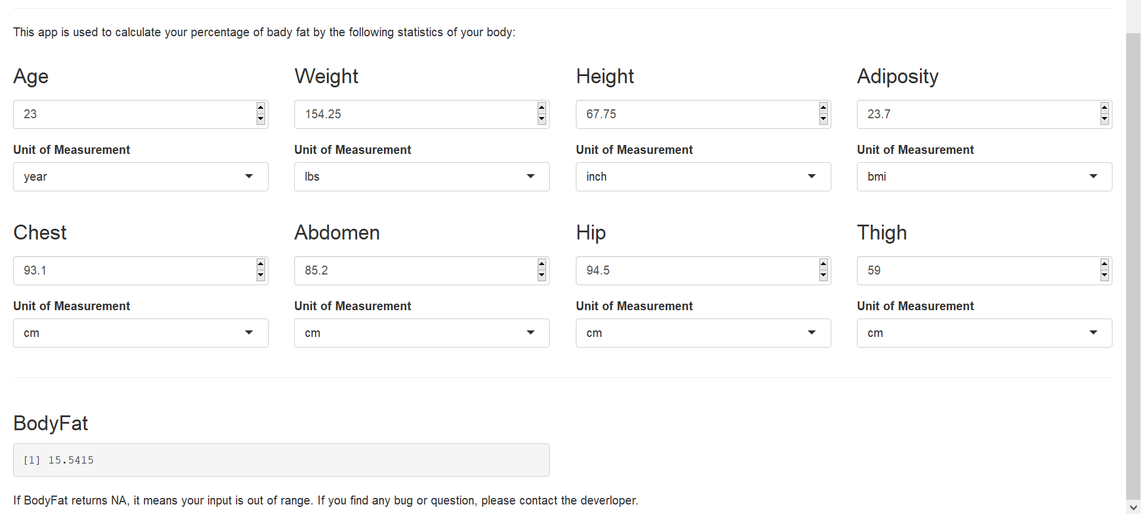
Shiny app

Slide 19
Thanks for listening!

